Slide 1
Session 12
Review:
Review Exercise
Stuff organizer
Foreach, While
ArrayList
Arrays
For-loops & Arrays
ArrayExercise:
Stuff organizer with array and for-loop
Exercises
BlueJ chapter. 7 (6th edition)

Slide 2
Code Conventions
Industry standard
1.1 Why Have Code Conventions
Code conventions are important to programmers for a number of reasons:
80% of the lifetime cost of a piece of software goes to maintenance.
Hardly any software is maintained for its whole life by the original author.
Code conventions improve the readability of the software, allowing engineers to
understand new code more quickly and thoroughly.
If you ship your source code as a product, you
codeconventions-150003.pdf

Slide 3
0..*
ArrayList
add(<Type> object);
<Type> get(int i);
int size();
remove(int i);
....
A
*
B
import java.util.ArrayList;
public class A{
private ArrayList<B> myCollection;
....
public A(){
....
myCollection = new ArrayList<B>();
}
....
public void addElement(B newB){
myCollection.add(newB);
}
....
}
public class B{
....
}

Slide 4
Exercise: Stuff Organizer
Solve exercise 1-3
Work efficiently and quickly
If stuck: Ask immediately, don’t fall behind!

Slide 5
Arrays: Fixed-size collections
Sometimes the maximum collection size can be pre-determined.
Programming languages usually offer a special fixed-size collection type: an array.
Java arrays can store objects or primitive-type values.
Access to items in arrays is more efficient compared to those stored in flexible-sized arrays.
Arrays can hold primitive types – that’s more efficient
Arrays are also more inflexible and difficult to work with
ArrayLists are more flexible – that’s easier to code and extend
JIT optimization makes ArrayList similar in performance
Special syntax (arrays).

Slide 6
The weblog-analyzer project
Web server records details of each access.
Supports webmaster’s tasks.
Most popular pages.
Busiest periods.
How much data is being delivered.
Broken references.
Analyzes access by hour.

Slide 7
Creating an array object
Array variable declaration
public class LogAnalyzer {
private int[] hourCounts;
private LogfileReader reader;
public LogAnalyzer(){
hourCounts = new int[24];
reader = new LogfileReader();
}
...
}
Array object creation
Must specify size

Slide 8
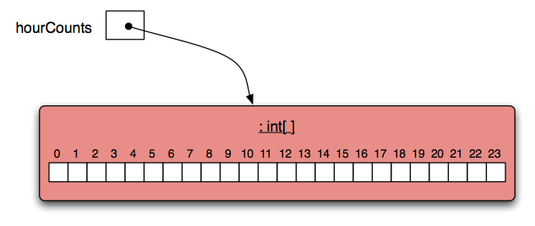
The hourCounts array

Slide 9
Using an array
Square-bracket notation is used to access an array element: hourCounts[...]
Elements are used like ordinary variables.
On the left of an assignment:
hourCounts[hour] = ...;
In an expression:
adjusted = hourCounts[hour] – 3;
hourCounts[hour]++;

Slide 10
Array literals
declaration and initialization
private int[] numbers = { 3, 15, 4, 5 };
Array literals can only be used in initialization.

Slide 11
Array length
private int[] numbers = { 3, 15, 4, 5 };
int n = numbers.length;
no brackets!
Note: length is not a method!!

Slide 12
The for loop - example
for(initialization; condition; post-body action) {
statements to be repeated
}
for(int hour=0; hour<hourCounts.length; hour++) {
System.out.println(hour + ": " +
hourCounts[hour]);
}
Make this example work!

Slide 13
Loop
General form of a for loop
for(initialization; condition; post-body action){
statements to be repeated
}
Not possible to change the number of elements in the collection
General form of the for-each loop
for(ElementType element : collection) {
loop body
}
General form of the while loop
initialization;
while(condition) {
statements to be repeated
post-body action
}

Slide 14
Exercise: Stuff Organizrer
Solve the Arrays exercise
Solve exercise 4.
This is where we use the for-loop
For-loops are king! For-loops for president!
Also, practice the correct code conventions!
http://www.oracle.com/technetwork/java/codeconventions-150003.pdf
Always stick to the conventions
Solving exercise 5 is optional
But interesting and very rewarding

Slide 15
Review
Arrays are appropriate where a fixed-size collection is required.
Arrays use special syntax.
For loops offer an alternative to while loops when the number of repetitions is known.
For loops are used when an index variable is required.

Slide 16
Exercises
Exercises from last session
Log Analyzer project open the one under session 10 (webLogAnalyzerWtihAllClasses)
7.1 – exploring the LogAnalyzer project
7.10 – rewriting a for-loop to a while loop
7.14 – add numberOfAccess method
7.15 - add busiestHours method
7.16 – add quietestHour method
7.18 – add a method finding the two-hour period which is the busiest

